Slide 1
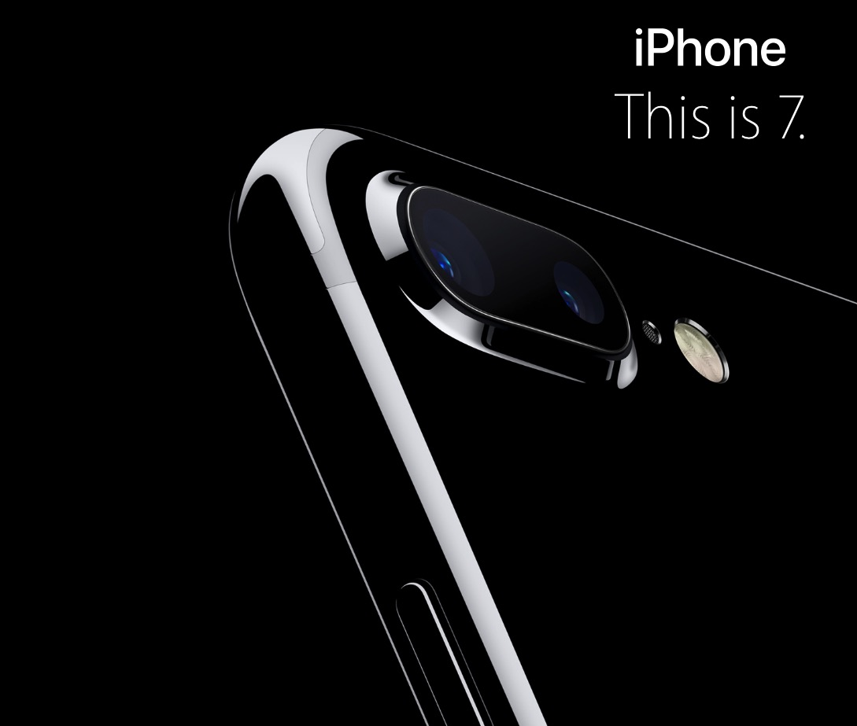
DS501
Case Study Report
No.1
Group 10
Jiexuan Sun, Chao Xu, Zhaoning Su, Congyang Wang
source: apple.com
Notes:
Thank you professor, Hello everyone, I am so happy to be here to `share with you guys what awesome things we learned and found from this case study.
Okay, now who can tell me what is this cool thing? Yes, iPhone7 plus. That is the topic we use in this case study.

Slide 2

WHY
licensed under Creative Commons Zero
Notes:
So, why we choose this,

Slide 3
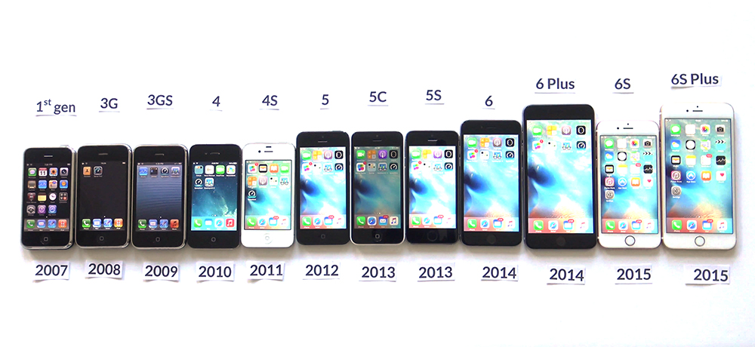
iPhone Empire
http://betanews.com/wp-content/uploads/2015/09/All-iPhones.jpg
Notes:
With the first generation iPhone released by Steve Jobs, the Apple Inc. finally came back to the public view and in these past years every September keynote which can introduce the new iPhone became a carnival for the fans of Apple, at the same time apple’s products start to be fashion icons. But, with Steve Jobs passed away, from the iPhone4S which didn’t make a lot of change compare with the previous iPhone4, there was a voice “Apple start to give up the innovation and perfect products.” or some similar criticisms.

Slide 4
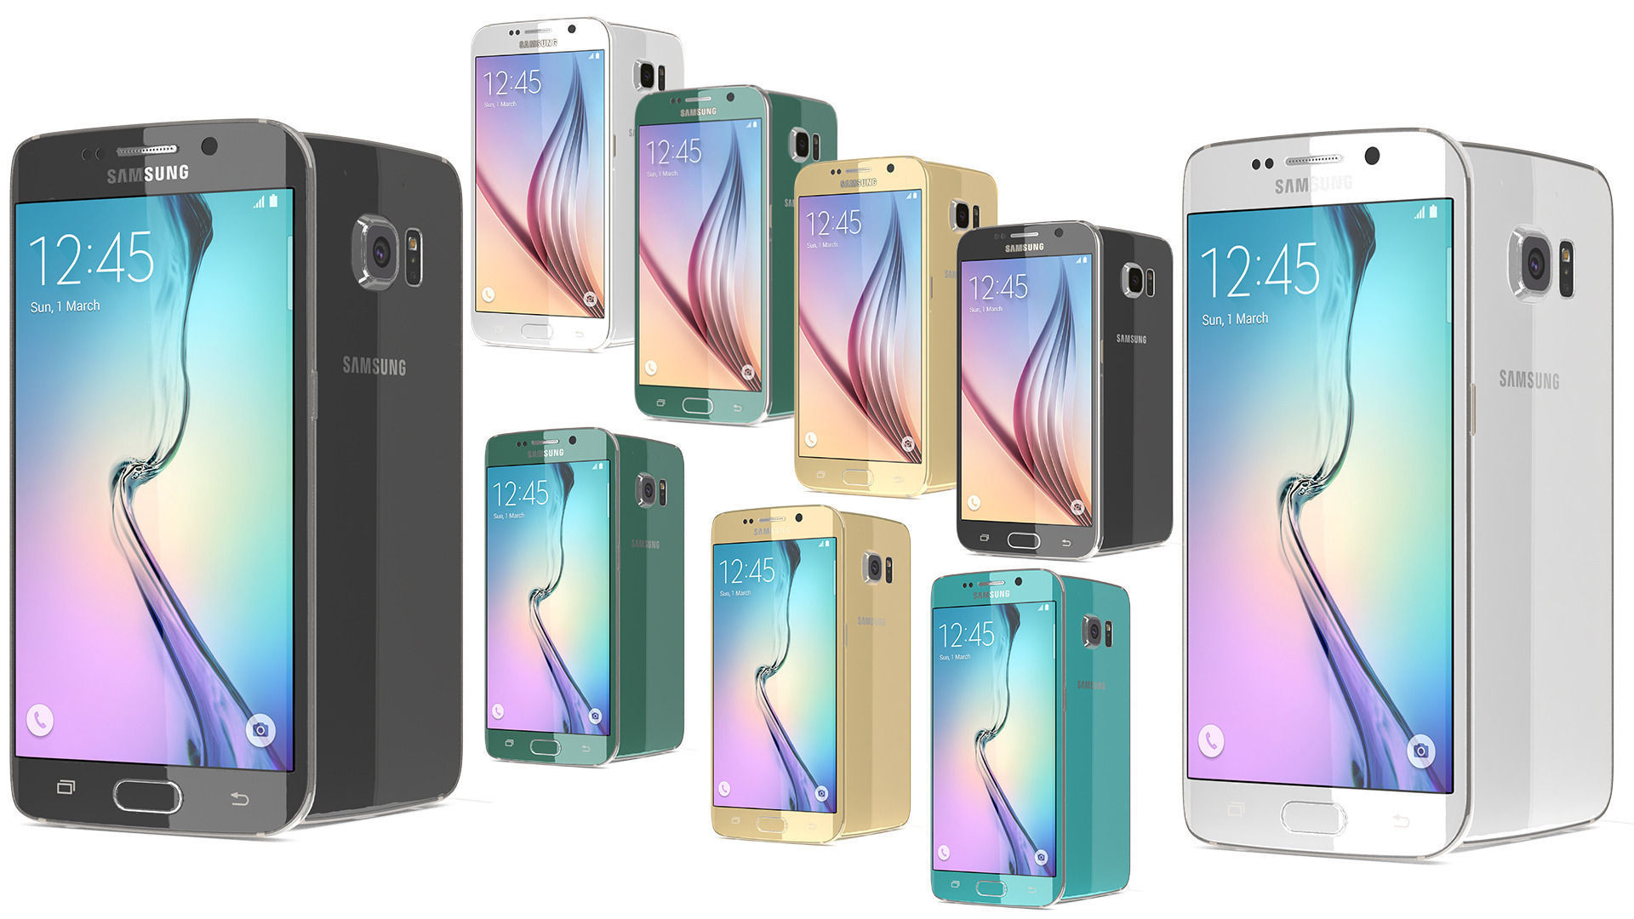
Galaxy Empire
Notes:
there is a new empire is growing so fast with Android’s fast moving.
With these negative comments and the Android’s fast grow. Samsung’s Galaxy mobile series sale volume jumped to the first tier with iPhone family.

Slide 5
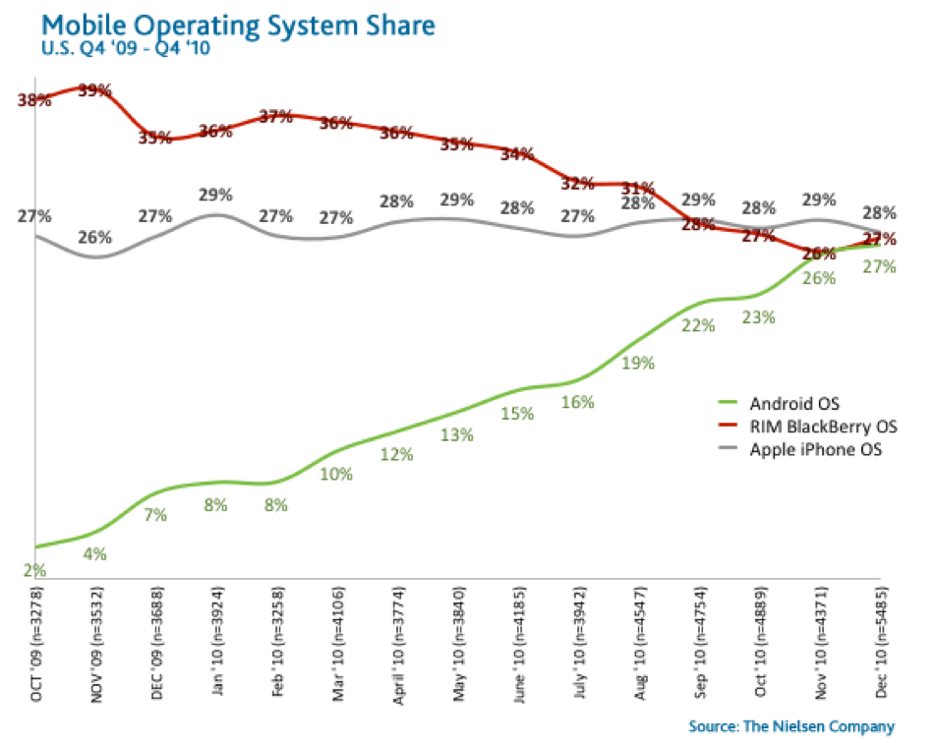
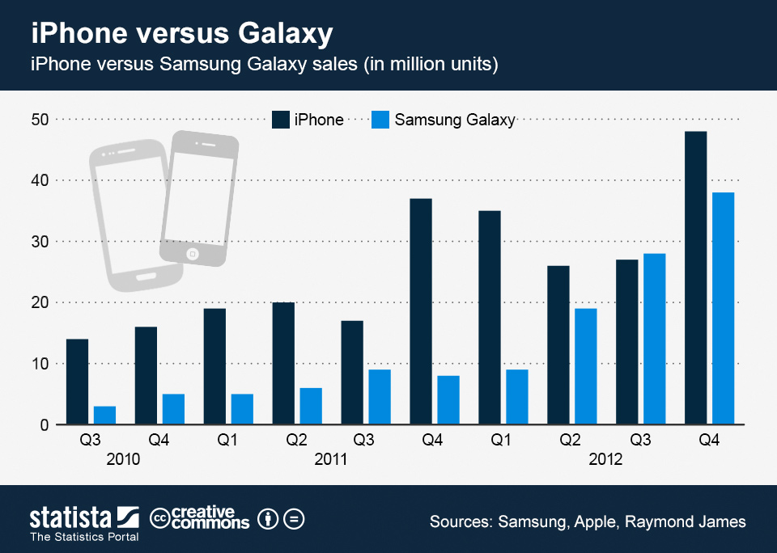
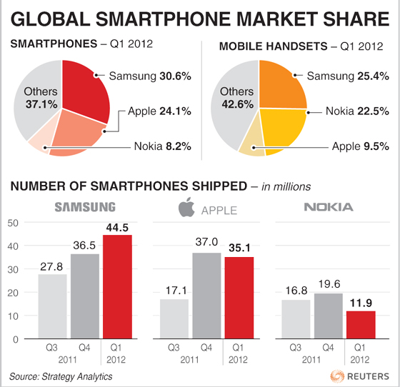
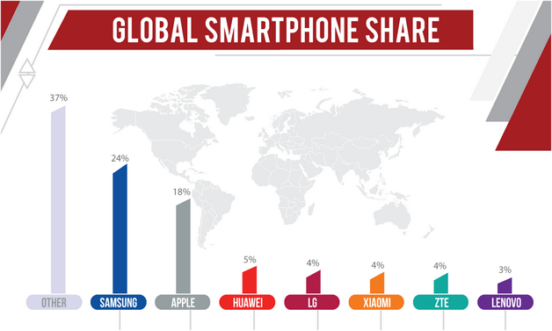
http://axeetech.com/2013/04/02/android-sprint-and-samsung-market-shares-on-the-rise/
http://www.smartphonemarketresearch.com/
Notes:
I even can show you more research report to prove that, the there is something wrong with Apple, with the iPhone, why the Samsung catch up so fast? (let’s forget the news about the galaxy note 7 exploding Battery Crisis.)

Slide 6

THAT’S WHY
licensed under Creative Commons Zero
Notes:
So that’s why we have interest on this topic, now it’s a kind of phenomenon, especially after the newest iPhone, iPhone7 released half a month ago, we are wondering what are public feeling about this apple product? Are they like or dislike it? What words they will use with the “iPhone7”? is this keynote is success to wake up the desire of public to buy an iPhone7? Which parts they love? If “Tim Cook” the CEO of Apple Inc. the successor of the Steve Jobs will make this company go further and make a strong influence in the future?

Slide 7

WHAT WE FOUND

Slide 8
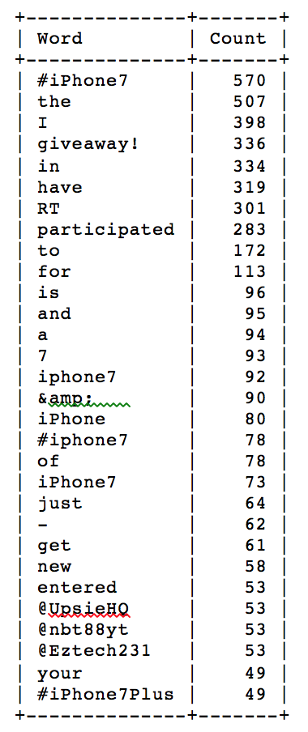
FOUND 1
We found:
There are a lot of prepositions, so we found data clean is very very important for analysis.
“giveaway”, “participated” come up in the top, so we found there are a lot of people want to get the free pizza.
In this top 30 list, we also found “#iPhone7Plus” come up, it may shows that some people even care if the iPhone7Plus is their next choice.
Notes:
1000 个 数据 用了词频, 内容中 前30个
1. 很多都是介词, 证明我们话应该可以找到更好的filter方法.
2. giveaway participated, 出现频率高, 都喜欢不劳而获.
3. plus的出现, 表示他们也在关注或许选择plus

Slide 9
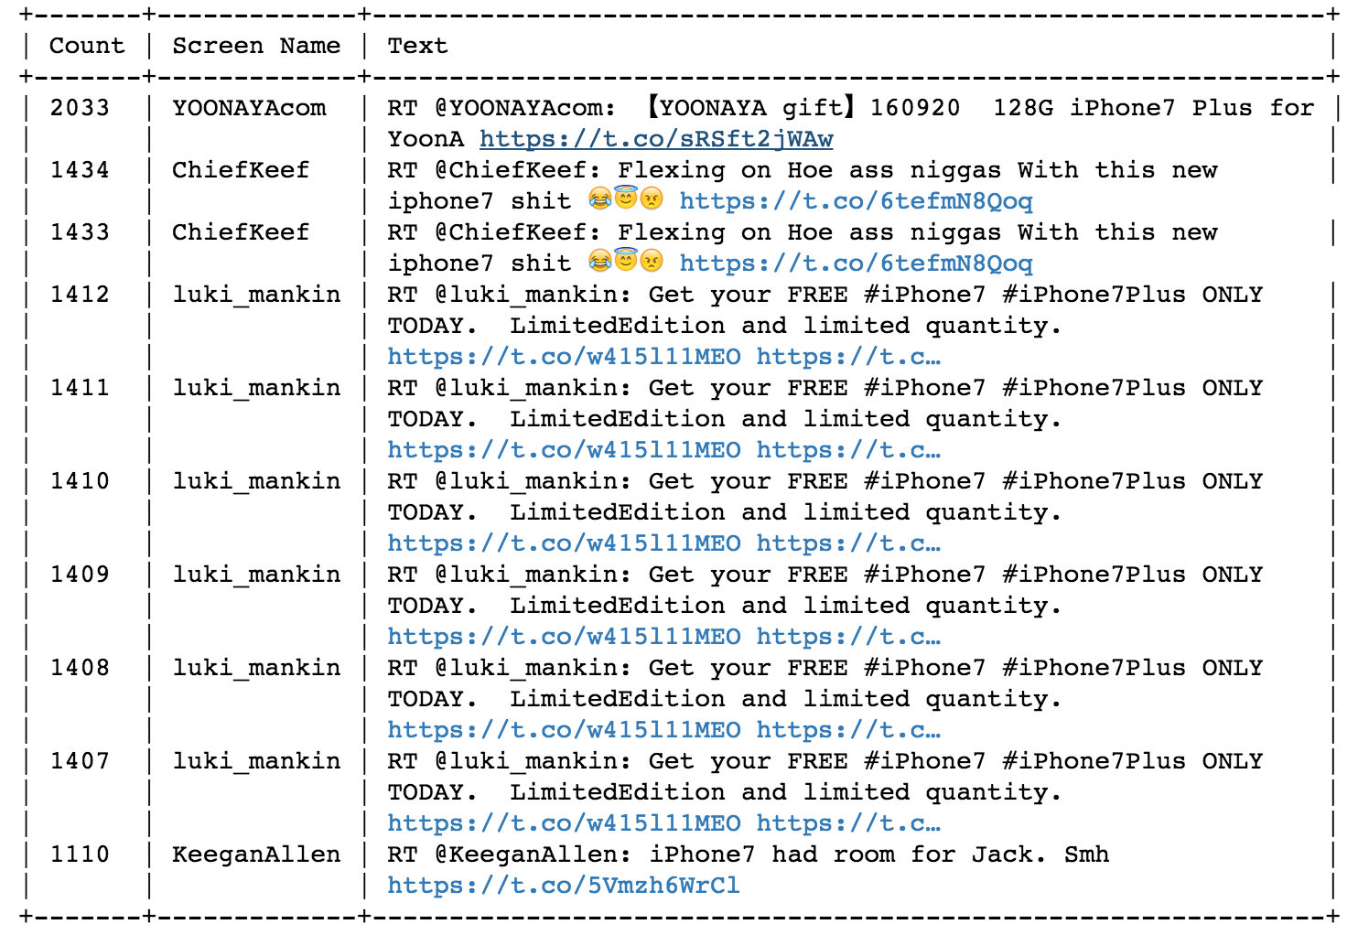
FOUND 2
We found:
The most RT tweet is a tweet about a lottery of free iPhone7. Everybody love the free pizza again!
We found there is a user”luki_mankin”keep RT his tweet and never stop, it looks like a “zombie fans”, hope Twitter will kill them all.
Notes:
转发最多的 一条微博 是个抽奖tweet, 有一个人自己在不停的rt自己的内容, 就是抽奖. 建议推特通过我们这种方法, 过滤这种用户.

Slide 10
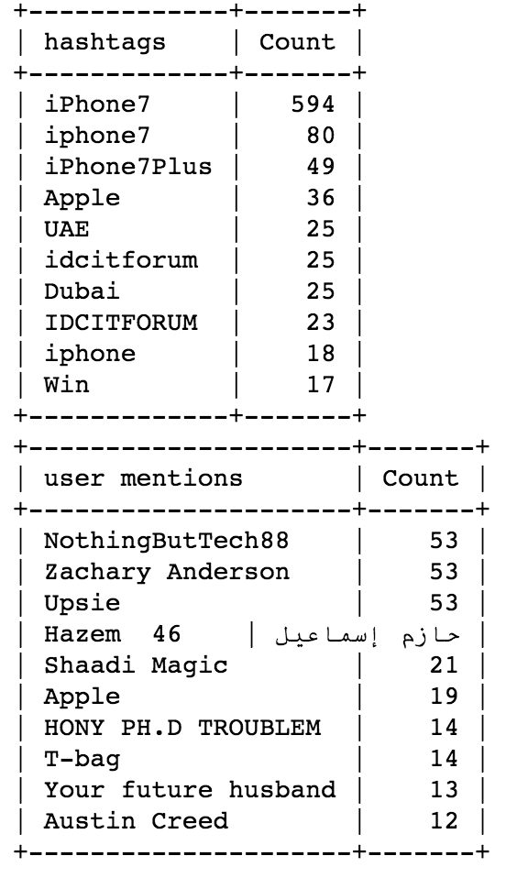
FOUND 3
We found:
Dubai appearance is very interesting, looks like they are really rich.
There are a lot of specific words or names were mentioned, I think that is the new tech fashion.

Slide 11
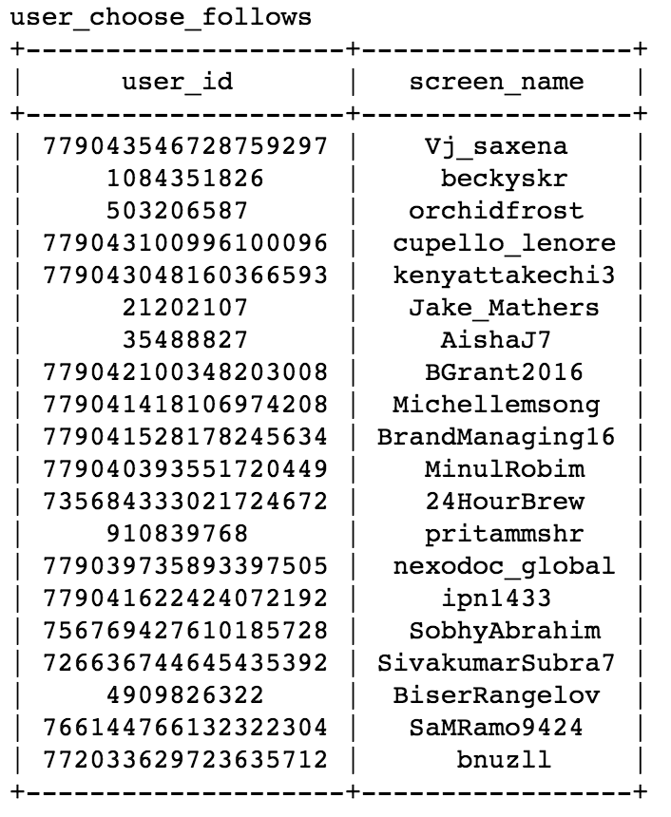
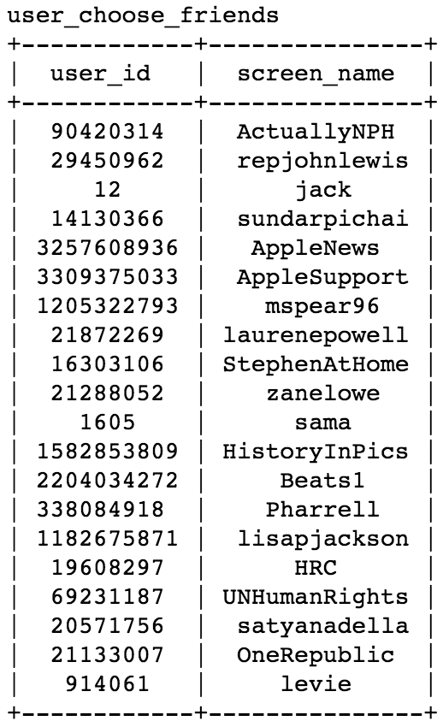
FOUND 4
We found:
(About Tim Cook)
This is Tim Cook the CEO’s world, it looks really strange for folks.
Jack, the number 12 user and co-founder of Twitter is following Tim Cook.

Slide 12
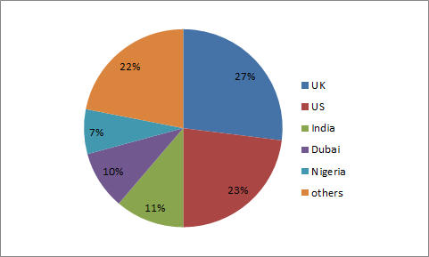
FOUND 5
We found:
We can get the number of twitters in different location. It shows that the degree of concern for iphone7 in different countries. The most is from UK and next is US.
This situation is not beyond our expectation. India is the 3rd place because it's the country of most population which speaking English. Andi. Dubai rank the 4th maybe because there are a lot of rich in the country.

Slide 13
FOUND 6
IS
What we learned:
We need remove the noise next time.
Consider about what is the package limit.

Slide 14

This is our story
how about yours?

